Slide 1
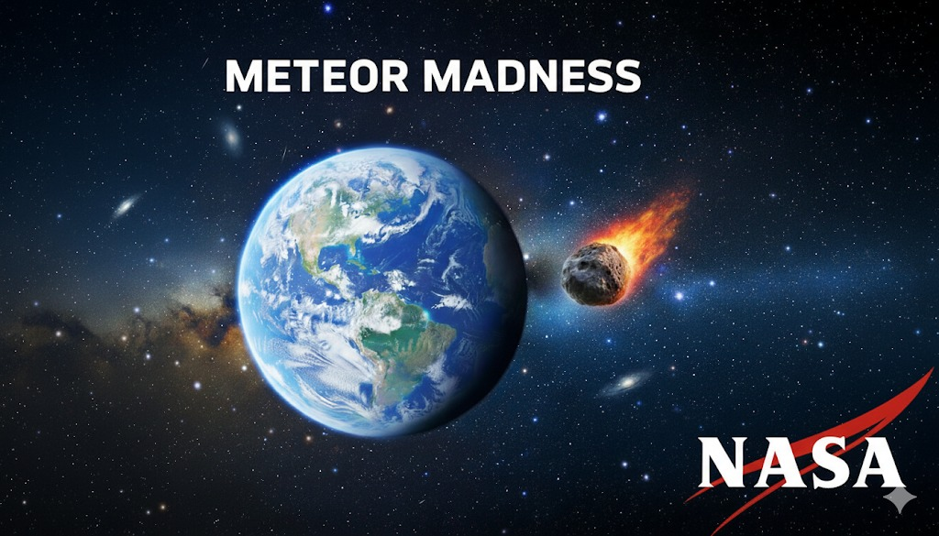
NASA Space Apps Challenge 2025
Title: Astro-Impact Simulator (Meteor Madness)
Team Name: Solo Coder – Vivan Pandya
College: PDEU – Computer Science & Engineering
Project Category: Planetary Defense / Impact Simulation
Hosted On: https://vivanpandya.github.io/Astro-Impact-Simulator-Meteor-Madness-/

Slide 2
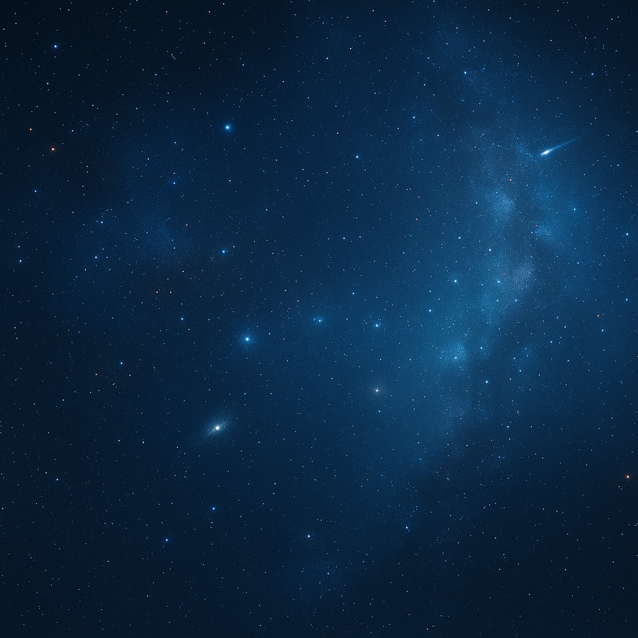
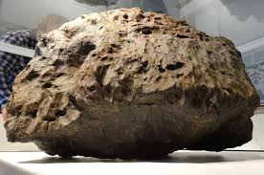
The Challenge
Piece of the Chelyabinsk Meteor that fell in Russia. It did not hit the ground but exploded in the air at 30 km altitude on February 15, 2013.
Photo: Andrey Yarantsev
Piece of the Chelyabinsk Meteor that fell in Russia. It did not hit the ground but exploded in the air at 30 km altitude on February 15, 2013.
Photo: Andrey Yarantsev
Problem Context:
Earth is under constant threat from Near-Earth Objects (NEOs) — asteroids, meteoroids, and comets that occasionally come dangerously close.
These impacts can trigger massive natural disasters such as:
🌋 Earthquakes due to seismic shockwaves
🌊 Tsunamis when impacts occur in oceans
🕳 Crater formation and destruction of nearby regions
Problem:
Existing scientific models that simulate asteroid impacts are often:
Too complex and require advanced knowledge
Not accessible for students, educators, or general audiences
Lack real-time interactivity and easy visualization
Goal:
To build a web-based interactive simulator that:
Visualizes asteroid impact effects such as craters, tsunamis, and earthquakes
Uses NASA’s Near-Earth Object API and elevation data for realism
Makes scientific visualization simple, educational, and engaging

Slide 3
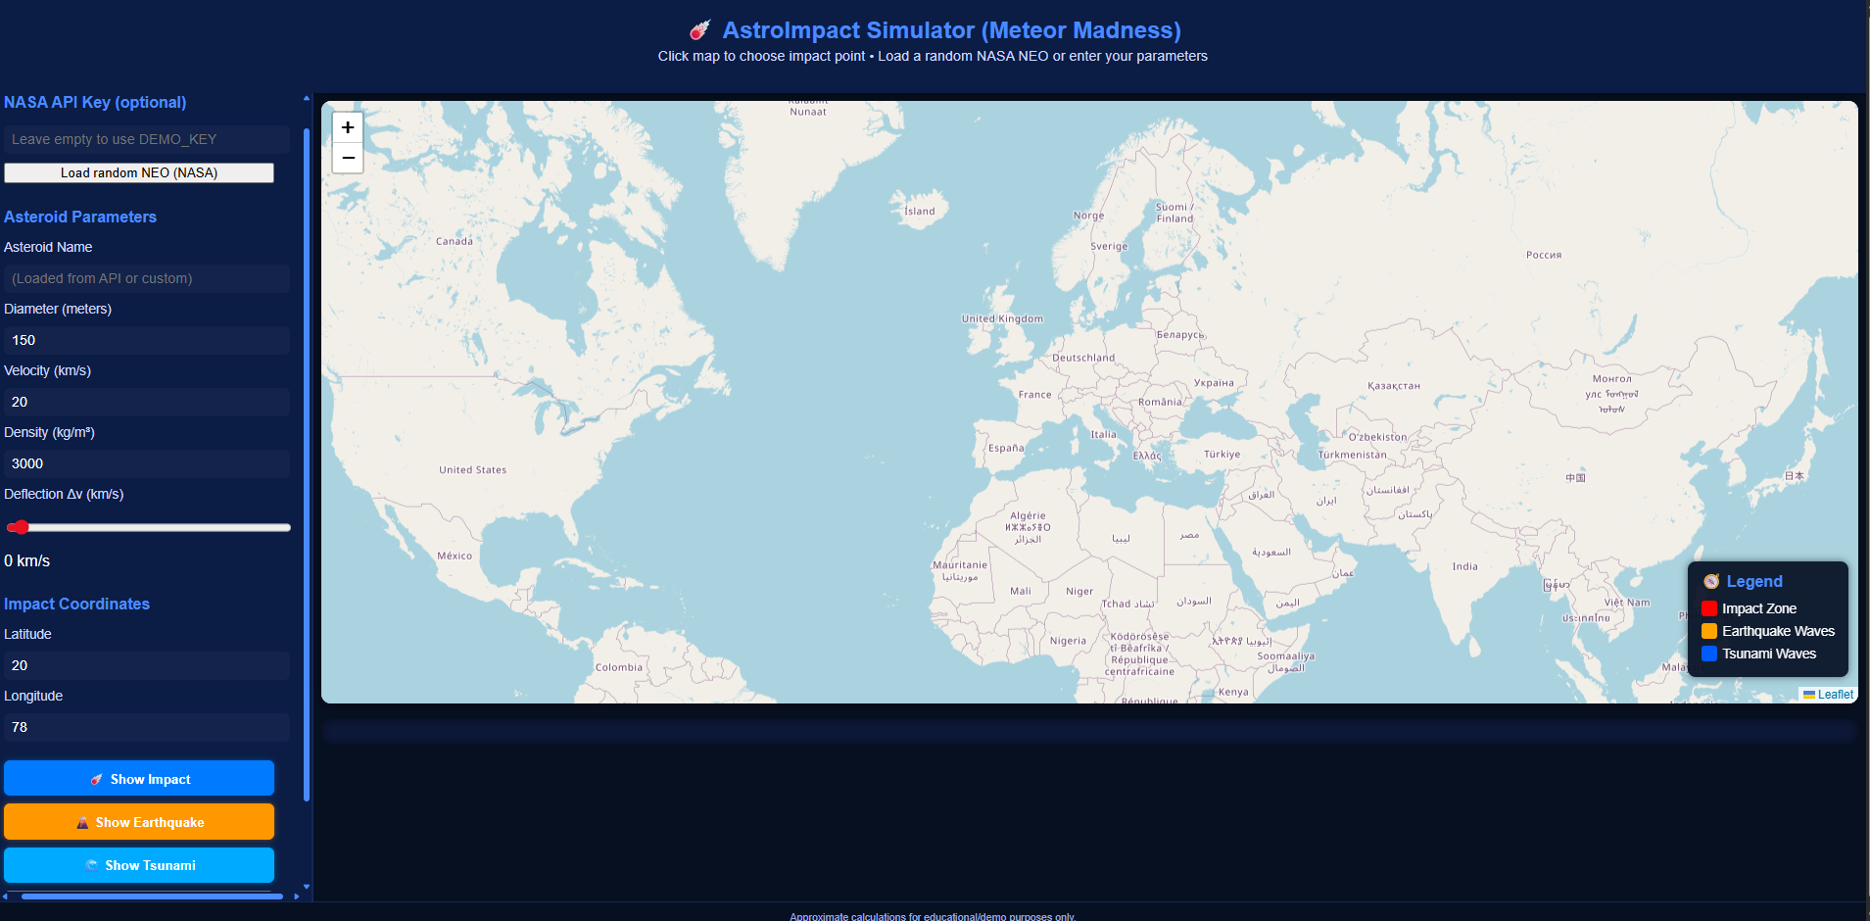
Our Solution – Astro-Impact Simulator
Key Features:
☄️ Asteroid Impact Simulation
🌋 Earthquake Modeling
🌊 Tsunami Propagation
🗺 Interactive Map Interface
🧮 Real-Time Physics Calculations
🔗 NASA API Integration
Core Objective: To make complex space-impact science accessible through interactive visuals, empowering students, researchers, and the public to understand and predict asteroid impact scenarios.
Interactive Impact Simulation Interface

Slide 4
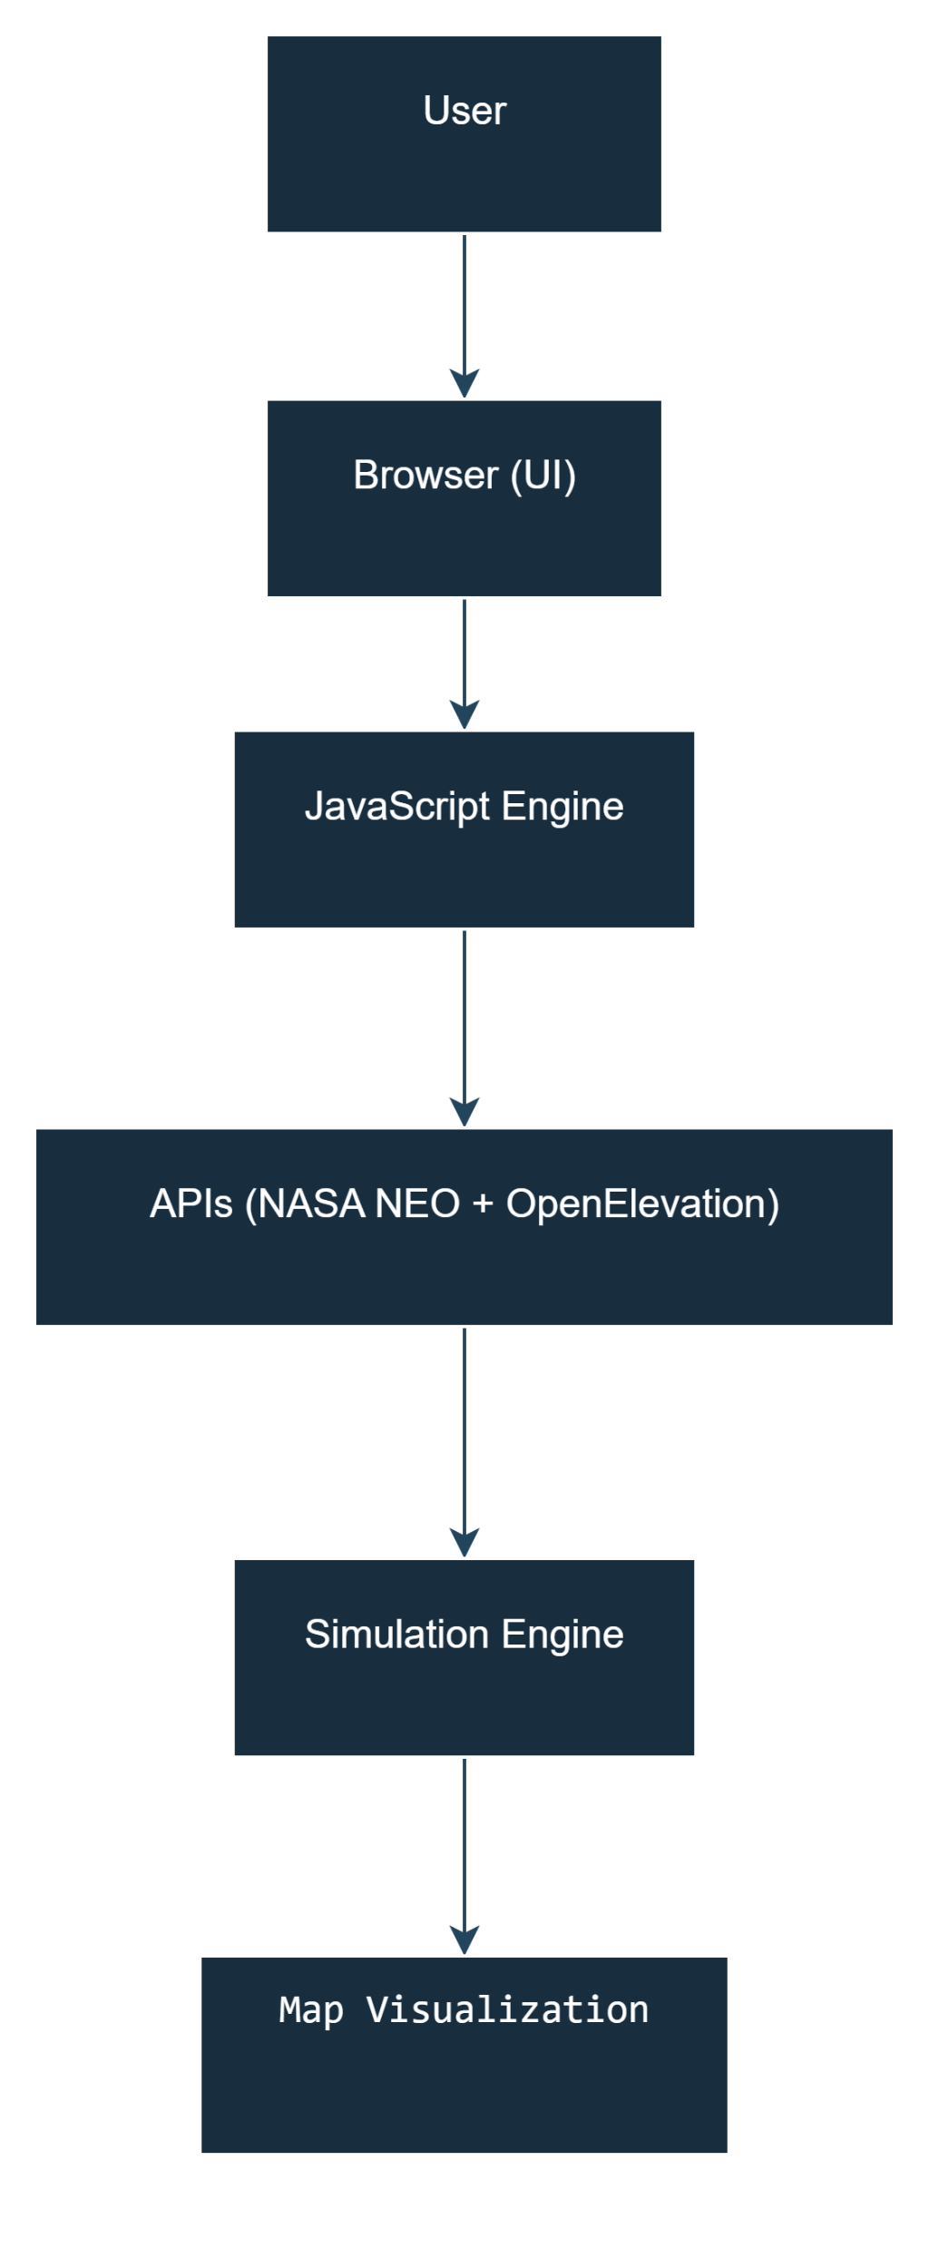
System Architecture – How It Works
User Interaction:
Users interact via an intuitive web interface built with HTML, CSS, and JavaScript (Leaflet.js)
Users select asteroid parameters or load real data from NASA APIs
Click on map to choose impact coordinates
Purpose: Input data + trigger simulations in real-time
Data Processing & Simulation:
Uses physics-based calculations for energy, crater diameter, and seismic intensity
Fetches real asteroid data via NASA NEO API
Fetches terrain elevation using Open Elevation API
Computes potential tsunami radius and impact damage
Tech Stack: JavaScript (Computation Engine) | Leaflet.js (Map Rendering) | Fetch API (Data Access)
Visualization & Output:
Displays impact zones, shockwave rings, and tsunami propagation on an interactive Leaflet map
Shows results (energy, magnitude, radius) dynamically in the Results Panel
Real-time animations for better user understanding

Slide 5
Key Features & Technologies Behind Astro-Impact Simulator
Main Features:
☄️ Asteroid Impact Simulation — Calculates crater size, energy, and visual impact zone.
🌋 Earthquake Modeling — Estimates equivalent magnitude and shows seismic rings.
🌊 Tsunami Prediction — Simulates water wave spread for oceanic impacts.
🗺️ Interactive World Map (Leaflet.js) — Allows users to click and instantly set impact coordinates.
🛰️ Real NASA Data Integration — Pulls asteroid data live using NASA’s NEO API.
🏔️ Elevation-Based Logic — Uses Open Elevation API to detect if impact is on land or ocean.
💻 Responsive UI Design — Optimized layout for clarity and easy simulation.
Technologies Used:
Category | Tools / Frameworks
Frontend | HTML5, CSS3, JavaScript (ES6)
Visualization | Leaflet.js (Map Rendering), Chart.js (Impact Metrics Graphs)
APIs Used | NASA NEO API, Open-Elevation API
Design | Custom CSS Styling, Gradient UI, Interactive Buttons
Hosting | GitHub Pages
Version Control | Git & GitHub Repository

Slide 6
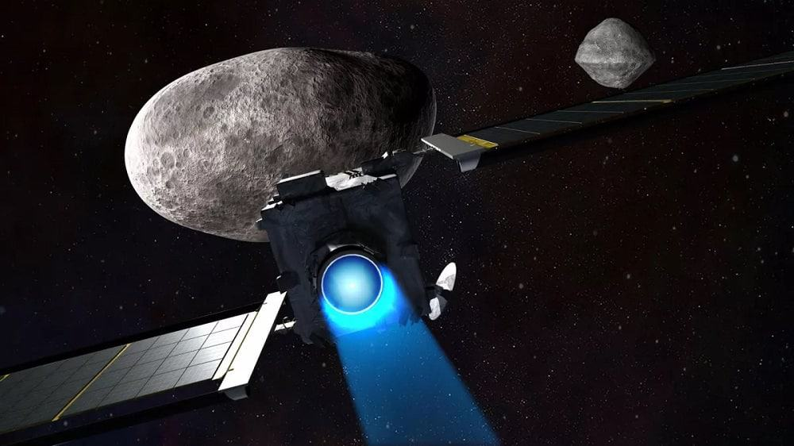
Simulation Outcomes & Real-World Impact
The Astro-Impact Simulator successfully models asteroid impacts, earthquakes, and tsunamis in real-time on an interactive map.
Users can select any global location, enter asteroid parameters, and visualize energy release, crater size, and shockwave spread.
Integration of NASA NEO API and Open Elevation API provides accurate environmental context.
The interface is educational, helping students and researchers understand the effects of celestial impacts intuitively.
Promotes public awareness about near-Earth hazards and disaster preparedness through simulation and visualization.
Impact Achieved:
Real-time scientific visualization made accessible to everyone.
A step towards STEM education and space hazard awareness.
Bridges the gap between complex data and interactive learning.

Slide 7
Conclusion & Future Enhancements
Conclusion:
The Astro-Impact Simulator successfully demonstrates how real-time data and visualization can simplify understanding of asteroid impact phenomena.
It combines NASA’s Near-Earth Object (NEO) data with geospatial visualization to simulate realistic outcomes.
The project enhances awareness and education, turning complex astronomical and geophysical concepts into interactive learning experiences.
Future Scope:
🌎 3D Visualization Upgrade: Integrate WebGL / Three.js for realistic 3D crater and wave rendering.
📡 Live Data Feed: Connect with NASA’s real-time asteroid tracking for continuous updates.
🌊 Tsunami Risk Modeling: Include bathymetric (sea floor) data for more accurate water simulations.
🤖 AI Prediction Model: Train a model to predict impact severity and suggest deflection strategies.
🛰️ Mobile Version: Build a mobile-responsive interface for broader accessibility.
“Astro-Impact turns space science into experience — bridging data, design, and discovery.”
Links:
Project link: https://vivanpandya.github.io/Astro-Impact-Simulator-Meteor-Madness-/
Github repository link: https://github.com/vivanpandya/Astro-Impact-Simulator-Meteor-Madness-

